Slide 1
CNS Project By:
Jay Patel (18DCS070)
Smit Shah(18DCS112)
Under Supervision off:
Prof. Vidhi Pandya
01
ENCRYPTION / DECRYPTION OF FILE USING AES ALGORITHM

Slide 2
Outlines :
•Abstract.
•AES Symmetric Encryption Algorithm.
•Working of AES Algorithm.
•Advantages of AES Algorithm
•What is Fernet ?
•Flow Chart
•Snap Shot of Code
•References

Slide 3
Abstract:
•Encryption and Decryption of video, image, text files etc.
•Using AES Symmetric Encryption Algorithm.
•Using Fernet library.

Slide 4
AES Symmetric Encryption Algorithm
•Symmetric key symmetric block cipher.
•128-bit data, 128/192/256-bit keys.
•Developed as an alternative to the DES algorithm.
•Unlike DES, AES is a family of block ciphers that consists of ciphers of different key
lengths and block sizes.
•Provide full specification and design details.
•Software implementable in C and Java.

Slide 5
Working of AES Symmetric Encryption Algorithm
•AES works on the methods of substitution and permutation.
•The plaintext data is turned into blocks, and then the encryption is applied using the
encryption key.
•The encryption process consists of various sub-processes such as sub bytes, shift rows, mix
columns, and add round keys.
•Depending upon the size of the key, 10, 12, or 14 such rounds are performed.
•The last round doesn’t include the sub-process of mix columns among all other sub-processes
performed to encrypt the data.

Slide 6
The Advantage of Using the AES Encryption Algorithm
•It is safe, fast, and flexible.
•Much quicker algorithm compared to DES.
•Multiple key length options are the biggest advantage.
•Like, for 128 bit, about many attempts are needed to break. This makes it very
difficult to hack it as a result it is very safe protocol.

Slide 7
What is Fernet?
•Fernet is included in the cryptographic library.
•Fernet is an implementation of symmetric (also known as “secret key”) authenticated
cryptography.
•Fernet guarantees that a message encrypted using it cannot be manipulated or read
without the key.

Slide 8
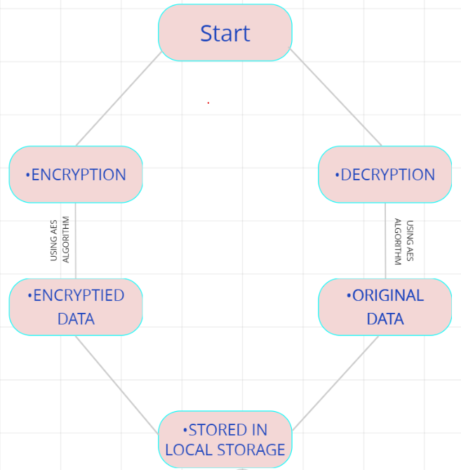
Flow Chart

Slide 9
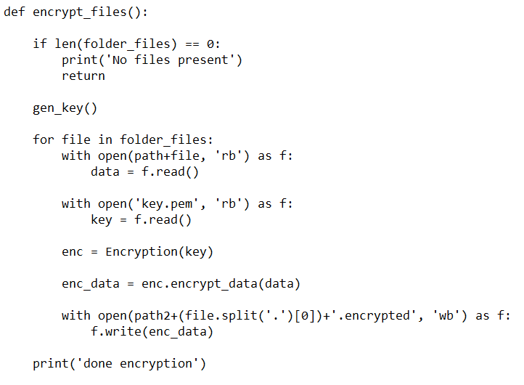
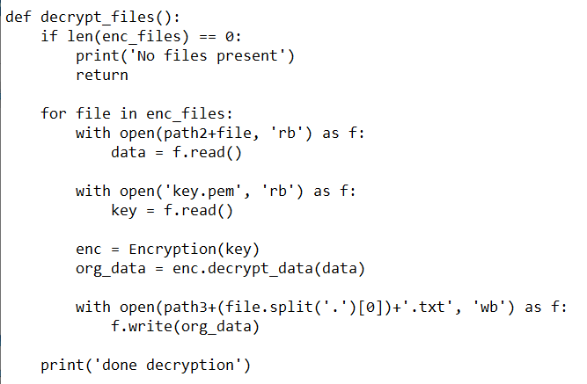
Snapshot of Code
Encryption :
Decryption :

Slide 10
References
•https://www.tutorialspoint.com/cryptography/advanced_encryption_standard.html
•https://www.geeksforgeeks.org/fernet-symmetric-encryption-using-cryptography-module-in-python/
•https://levelup.gitconnected.com/encrypt-and-decrypt-files-using-python-python-programming-pyshark-a67774bbf9f4
•https://www.youtube.com/watch?v=zWNA2ThkVT4&feature=emb_logo
•https://www.rfwireless-world.com/Terminology/Advantages-and-disadvantages-of-AES.html

Slide 11



Thank you

